Slide 1

Module4
. UI BINDING LIBRARY FOR REACT (09) Introduction to client-side routing using React Router, global state management and transitions using REDUX, server side rendering and testing using Jest, Enzyme and more. Web Development Using REACT is delivered both in a blended learning and self-paced mode.

Slide 2
What is reactJS
JavaScript Library (Free & open Source) Devolved by Facebook Engineer Create Single Page Applications Web & Mobile Applications component-based front end library Latest stable version:18.2.0

Slide 3
Why reactJS
Component Based Architecture Uses Virtual DOM for fast rendering Easy To Learn

Slide 4
Why reactJS
The main objective of ReactJS is to develop User Interfaces (UI) that improves the speed of the apps. It uses virtual DOM (JavaScript object), which improves the performance of the app. The JavaScript virtual DOM is faster than the regular DOM. We can use ReactJS on the client and server-side as well as with other frameworks. It uses component and data patterns that improve readability and helps to maintain larger apps.

Slide 5
Why reactJS
Today, many JavaScript frameworks are available in the market(like angular, node), but still, React came into the market and gained popularity amongst them. The previous frameworks follow the traditional data flow structure, which uses the DOM (Document Object Model). DOM is an object which is created by the browser each time a web page is loaded. It dynamically adds or removes the data at the back end and when any modifications were done, then each time a new DOM is created for the same page. This repeated creation of DOM makes unnecessary memory wastage and reduces the perform.ance of the application

Slide 6
Why reactJS
The Virtual DOM is React's lightweight version of the Real DOM. Real DOM manipulation is substantially slower than virtual DOM manipulation. When an object's state changes, Virtual DOM updates only that object in the real DOM rather than all of them.

Slide 7
Why reactJS
How do Virtual DOM and React DOM interact with each other? When the state of an object changes in a React application, VDOM gets updated. It then compares its previous state and then updates only those objects in the real DOM instead of updating all of the objects. This makes things move fast, especially when compared to other front-end technologies that have to update each object even if only a single object changes in the web application.

Slide 8

Creating html elements using javascript
Example for h1 element Basic.html <body> <!-- <h1>hello students</h1>--> <script> let h1=document.createElement('h1'); h1.innerHTML=‘hello students'; document.body.appendChild(h1); </script> </body>

Slide 9
Creating html element using react by using CDN links
Basic.html
<head>
<meta charset="UTF-8">
<meta name="viewport" content="width=<device-width>, initial-scale=1.0">
<title>Document</title>
<script crossorigin src="https://unpkg.com/react@18/umd/react.development.js"></script>
<script crossorigin src="https://unpkg.com/react-dom@18/umd/react-dom.development.js"></script>
</head>
<body>
<div id="root">
</div>
<script src="./basic.js"></script>
</body>
</html>

Slide 10

Creating html element using react
Basic.js
let heading=React.createElement(
'h1',{
},
"this is react js demo"
)
let ele=document.getElementById("root");
let root=ReactDOM.createRoot(ele);
root.render(heading);

Slide 11
Creating more than one html element using react
Basic.html
<head>
<meta charset="UTF-8">
<meta name="viewport" content="width=<device-width>, initial-scale=1.0">
<title>Document</title>
<script crossorigin src="https://unpkg.com/react@18/umd/react.development.js"></script>
<script crossorigin src="https://unpkg.com/react-dom@18/umd/react-dom.development.js"></script>
</head>
<body>
<div id="root">
</div>
<script src="./basic.js"></script>
</body>
</html>

Slide 12
Creating more than one html element using react
Basic.js
let heading=React.createElement(
'h1',{
},
"this is react js demo"
)
let para=React.createElement(
'p',{
},
"hello students"
)
let wrapper=React.createElement(
'div',{
},
[heading,para]
)

Slide 13
Creating more than one html element using react
let ele=document.getElementById("root");
let root=ReactDOM.createRoot(ele);
root.render(wrapper)

Slide 14
React Basics
How to create React Application
Application Folder Structure
What is JSX
Components (Functional & Class)
Ways to apply CSS
Props
Conditional Rendering

Slide 15
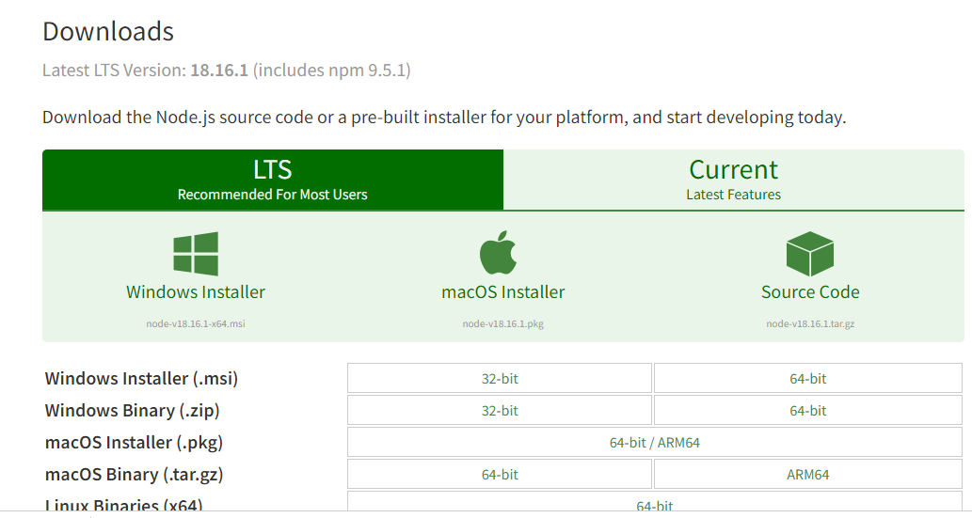
React js installation
Installation Reactjs on Windows:
Step 1: Install Node.js installer for windows. Click on this https://nodejs.org/en/download. Here install the LTS version (the one present on the left). Once downloaded open NodeJS without disturbing other settings, click on the Next button until it’s completely installed.

Slide 16

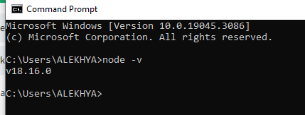
React js installation
Step 2: Open command prompt to check whether it is completely installed or not type the command –>

Slide 17
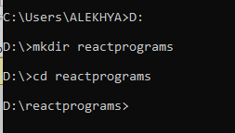
React js installation
Step 3: Open command prompt select any drive(D or E) then create directory by using mkdir command
mkdir foldername
Change into the folder by using cd command
cd foldername

Slide 18
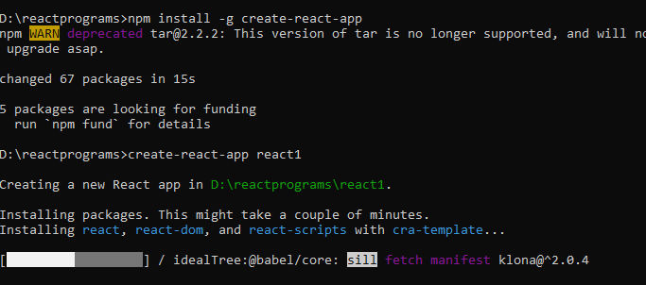
React js installation
Step 4: Next write the command
npm install –g create-react-app
create-react-app appname

Slide 19
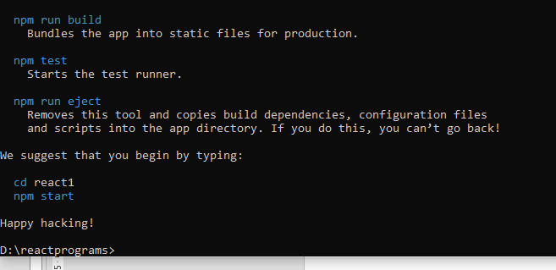
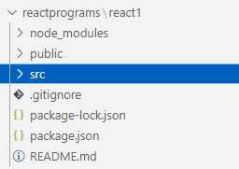
React js installation
Step 5: lot of folders and files are added into the app.finally we get msg like this

Slide 20

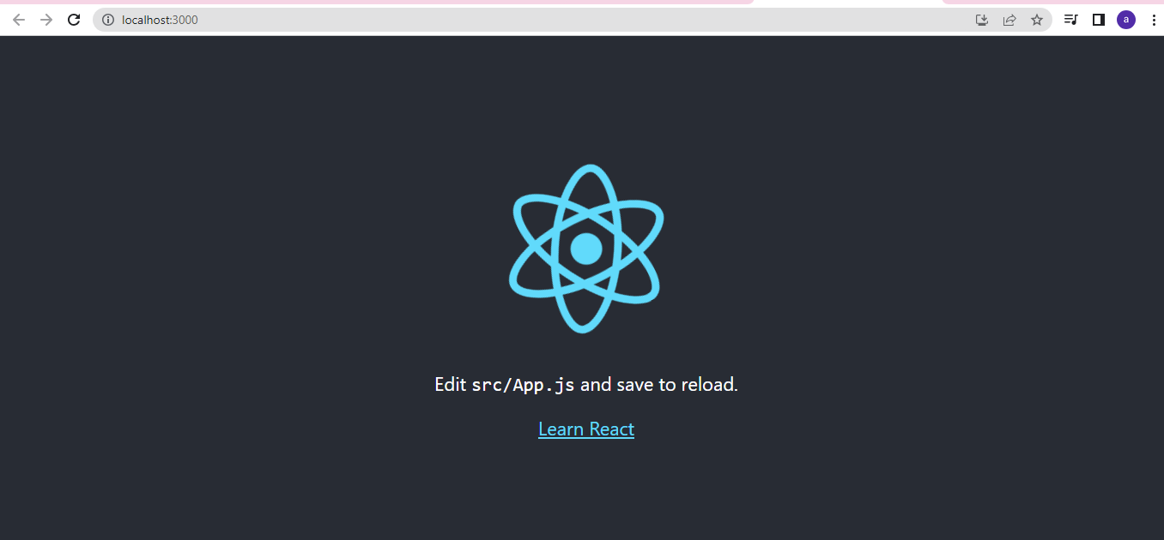
React js installation
Step 6: change Into the folder what u hv created as appname by using command
cd appname
Next write command
Npm start
To run our react application

Slide 21
Creating html element using react after installation WITH OUT CDN links
Index.html
<!DOCTYPE html>
<html lang="en">
<head>
<meta charset="utf-8" />
<link rel="icon" href="%PUBLIC_URL%/favicon.ico" />
<meta name="viewport" content="width=device-width, initial-scale=1" />
<meta name="theme-color" content="#000000" />
<meta
name="description"
content="Web site created using create-react-app"
/>
<link rel="apple-touch-icon" href="%PUBLIC_URL%/logo192.png" />
<link rel="manifest" href="%PUBLIC_URL%/manifest.json" />
<title>React App</title>
</head>
<body>
<noscript>You need to enable JavaScript to run this app.</noscript>
<div id="root"></div>
</body>
</html>

Slide 22

Creating html element using react after installation WITH OUT CDN links
Index.js
import React from 'react';
import ReactDOM from 'react-dom/client';
let heading=React.createElement(
'h1',{
},
"this is react js"
)
let ele=document.getElementById("root");
let root=ReactDOM.createRoot(ele);
root.render(heading);

Slide 23
React Folder structure
Public folder
● In this folder we will always have single html file (index.html) which runs on the server and we will edit this file.
● All the components are rendered on index file
● In the div with id root and displayed on the browser.

Slide 24
React Folder structure
Source Folder
This is our react application. All the script files are added in the source folder
App.css
App.js
App.test.js
index.css
index.js
logo.svg
reportWebVitals.js
setupTests.js

Slide 25
React Folder structure
package.json:
file contains react, react-dom, react-scripts dependencies
public folder:
entry point file of the entire application is index.html
<title>Contact Manager</title>
<body style="background-color:blue;">
<noscript>You need to enable JavaScript to run this app.</noscript>
<div id="root"></div>
</body>
<div id="root"></div> this is where the main app component is rendered. Every react application has a root component and every component we create is going into that app component.

Slide 26
React Folder structure
src folder:
Index.js
import React from 'react';
import ReactDOM from 'react-dom';
import './index.css';
import App from './App';
import reportWebVitals from './reportWebVitals';
ReactDOM.render(<App />, document.getElementById('root') );
reportWebVitals();

Slide 27
JSX
As we have already seen that, all of the React components have a render function. The render function specifies the HTML output of a React component.
JSX(JavaScript Extension), is a React extension which allows writing JavaScript code that looks like HTML.
In other words, JSX is an HTML-like syntax used by React that extends ECMAScript so that HTML-like syntax can co-exist with JavaScript/React code.
The syntax is used by preprocessors (i.e., transpilers like babel) to transform HTML-like syntax into standard JavaScript objects that a JavaScript engine will parse.

Slide 28
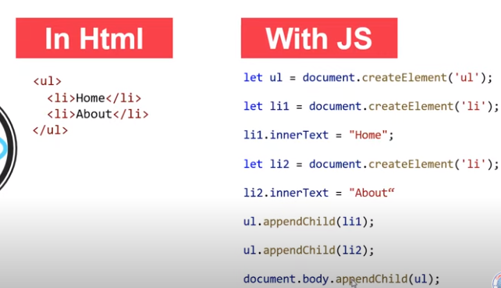
JSX

Slide 29
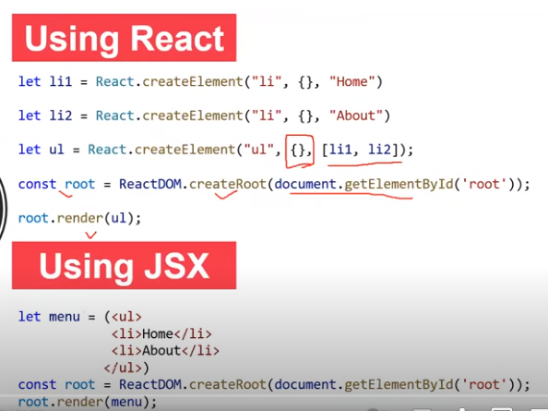
JSX

Slide 30
JSX
Index.html
<body>
<noscript>You need to enable JavaScript to run this app.</noscript>
<div id="root"></div>
</body>
</html>

Slide 31

Creating html element using jsx
Index.js
import React from 'react';
import ReactDOM from 'react-dom/client';
let ele=document.getElementById("root");
let root=ReactDOM.createRoot(ele);
root.render(<h1>hello</h1>);

Slide 32

Creating html element using jsx
Index.js
import React from 'react';
import ReactDOM from 'react-dom/client';
let ele=document.getElementById("root");
let root=ReactDOM.createRoot(ele);
let a='hello students'
root.render(<ul>
<li>home</li>
<li>department</li>
<li>{a}</li>
</ul>);

Slide 33
Creating html element using jsx
Assigning html element using jsx to some variable
import React from 'react';
import ReactDOM from 'react-dom/client';
let ele=document.getElementById("root");
let root=ReactDOM.createRoot(ele);
let a='hello students'
let menu=(<ul>
<li className="x">home</li>
<li id="y">department</li>
<li>{a}</li>
</ul>)
root.render(menu);

Slide 34
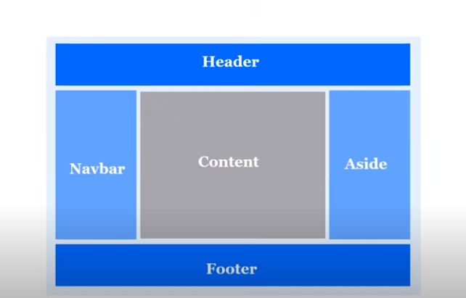
Components in react js
Any React Applications is made up of Components
Component is some code (html+css+JS)

Slide 35
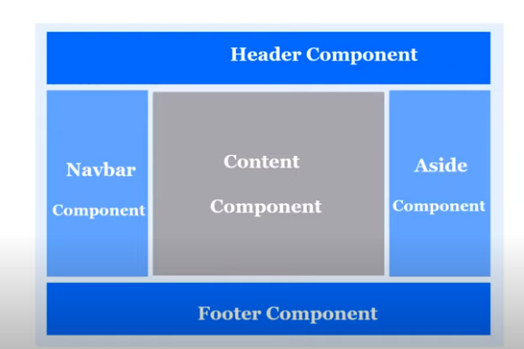
Components in react js

Slide 36
Components in react js
Types of components
Class components
Functional components.
Functional components
Functional components are simply javascript functions. We can create a functional component in React by writing a javascript function. These functions may or may not receive data as parameters

Slide 37

Components in react js
Index.js
import React from 'react';
import ReactDOM from 'react-dom/client';
let ele=document.getElementById("root");
let root=ReactDOM.createRoot(ele);
function Header()
{
return (
<header><ul>
<li>home</li>
<li>department</li></ul>
</header>
)}
root.render(<Header/>);

Slide 38

Components in react js
Arrays inside functions
Index.js
import React from 'react';
import ReactDOM from 'react-dom/client';
let ele=document.getElementById("root");
let root=ReactDOM.createRoot(ele);
function Header()
{
let array=['hi’,’department']
return (
<header><ul>
<li>{array[0]}</li>
<li>{array[1]}</li></ul>
</header>
)}
root.render(<Header/>);

Slide 39
Different ways to create functional components
we can create functional components in different ways like javascript
1.Named function
2.Arrow function
3.Anonymous function

Slide 40
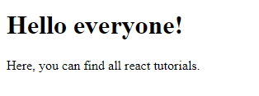
Different ways to create functional components
Arrow function example
index.js
import React from 'react';
import ReactDOM from 'react-dom/client';
let ele=document.getElementById("root");
let root=ReactDOM.createRoot(ele);
let App=()=>{
return (
<div>
<h1 className="hi">Hello everyone!</h1>
<p id="hello">Here, you can find all react tutorials.</p>
</div>
)
} root.render(<App/>)

Slide 41
Different ways to create functional components
Without using return also you can write arrow function if it is containing only one expression
Index.js import React from 'react';
import ReactDOM from 'react-dom/client';
let ele=document.getElementById("root");
let root=ReactDOM.createRoot(ele);
let App=()=>
<div>
<h1 className="hi">Hello everyone!</h1>
<p id="hello">Here, you can find all react tutorials.</p>
</div>
root.render(<App/>)

Slide 42
Different ways to create functional components
Anonymous function
import React from 'react';
import ReactDOM from 'react-dom/client';
let ele=document.getElementById("root");
let root=ReactDOM.createRoot(ele);
let App=function(){
return(
<div>
<h1 className="hi">Hello everyone!</h1>
<p id="hello">Here, you can find all react tutorials.</p>
</div> )
}
root.render(<App/>)

Slide 43
Components in react js
Class components The class components are a little more complex than the functional components. The functional components are not aware of the other components in your program whereas the class components can work with each other. We can pass data from one class component to another class component. We can use JavaScript ES6 classes to create class-based components in React.

Slide 44

Components in react js
Index.js
import React from 'react';
import ReactDOM from 'react-dom/client';
let ele=document.getElementById("root");
let root=ReactDOM.createRoot(ele);
class Menu extends React.Component
{
render()
{
return (
<header><ul>
<li>home</li>
<li>department</li></ul>
</header>
)
}
}
root.render(<Menu/>)

Slide 45
Imports and Exports in react
you may treat each React Component as a module itself. Thus, it is possible to import/export React Components and is one of the basic operations to be performed. In React we use the keyword import and from to import a particular module or a named parameter. Let us now see the different ways we can use the import operation in React.
Importing default export: Every module is said to have at most one default export. In order to import the default export from a file, we can use only the address and use the keyword import before it, or we can give a name to the import making the syntax as the following.
syntax
import GIVEN_NAME from ADDRESS

Slide 46


Imports and Exports in react
Importing named values: Every module can have several named parameters and in order to import one we should use the syntax as follows.
And similarly, for multiple such imports, we can use a comma to separate two-parameter names within the curly braces.
Importing a combination of Default Exports and Named Values: The title makes it clear what we need to see is that the syntax of the same. In order to import a combination, we should use the following syntax.

Slide 47

Imports and Exports in react
Exporting
Importing is possible only if the module or named property to be imported has been exported in its declaration. In React we use the keyword export to export a particular module or a named parameter or a combination. Let us now see the different ways we can use the import operation in React.
Exporting default export: We have already learned that every module is said to have at most one default export. In order to export the default export from a file, we need to follow the syntax described below.

Slide 48

Imports and Exports in react
Exporting named values: Every module can have several named parameters and in order to export one we should use the syntax as follows.
And similarly, for multiple such exports, we can use a comma to separate two-parameter names within the curly braces.

Slide 49
Imports and Exports in react
Example for named export
App.js
export let person={
name:'kesi',
age:7,
location:'TN’
}

Slide 50
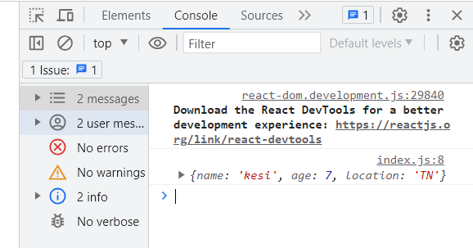
Imports and Exports in react
index.js
import React from 'react';
import ReactDOM from 'react-dom/client';
import {person} from './App';
let ele=document.getElementById("root");
let root=ReactDOM.createRoot(ele);
function Header()
{
console.log(person)
return (
<header><ul>
<li>home</li>
<li>department</li></ul>
</header>
)}
root.render(<Header/>);

Slide 51
Imports and Exports in react
Example for more than one named export
App.js
export let person={
name:'kesi',
age:7,
location:'TN'
}
export let x=10

Slide 52
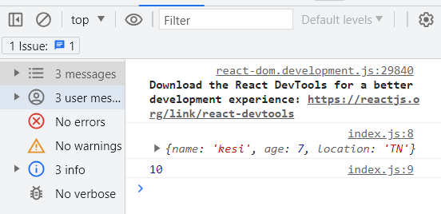
Imports and Exports in react
index.js
import React from 'react';
import ReactDOM from 'react-dom/client';
import {person,x as integer} from './App';
let ele=document.getElementById("root");
let root=ReactDOM.createRoot(ele);
function Header()
{
console.log(person)
console.log(integer)
return (
<header><ul>
<li>home</li>
<li>department</li></ul>
</header>
)}
root.render(<Header/>);

Slide 53
Imports and Exports in react
Example for named and default export
App.js
export let person={
name:'kesi',
age:7,
location:'TN'
}
let x=10
export default x
Note we can have any named exports but default is only one and default export is optional

Slide 54
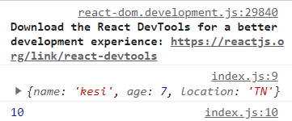
Imports and Exports in react
Index.js
import React from 'react';
import ReactDOM from 'react-dom/client';
import Integer ,{person} from './App';
let ele=document.getElementById("root");
let root=ReactDOM.createRoot(ele);
function Header()
{
console.log(person)
console.log(Integer)
return (
<header><ul>
<li>home</li>
<li>department</li></ul>
</header>
)}
root.render(<Header/>);

Slide 55
Imports and Exports in react
App.js
function App()
{
return(
<h1>iare college</h1>
)
}
export default App

Slide 56

Imports and Exports in react
Index.js
import React from 'react';
import ReactDOM from 'react-dom/client';
import App from './App'
let root=ReactDOM.createRoot(document.getElementById('root'));
root.render(<App />
);

Slide 57
Imports and Exports in react
Creating new component in src folder.By using import and export we are importing the component into app.js
Header.js
function header()
{
return(
<ul>
<li>home</li>
<li>departments</li>
<li>placements</li>
</ul>
)
}
export default header

Slide 58
Imports and Exports in react
App.js
import Header from './header'
function App()
{
return(
<div>
<Header/>
<h1>iare college</h1>
</div>
)
}
export default App

Slide 59
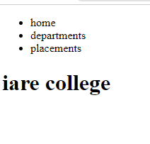
Imports and Exports in react
Index.js
import React from 'react';
import ReactDOM from 'react-dom/client';
import App from './App'
let root=ReactDOM.createRoot(document.getElementById('root'));
root.render(<App />
);

Slide 60
JSX attributes and Expressions
Attributes in JSX: JSX allows us to use attributes with the HTML elements just like we do with normal HTML. But instead of the normal naming convention of HTML, JSX uses the camelcase convention for attributes. For example, class in HTML becomes className in JSX. The main reason behind this is that some attribute names in HTML like ‘class‘ are reserved keywords in JavaScript. So, in order to avoid this problem, JSX uses the camel case naming convention for attributes. We can also use custom attributes in JSX. For custom attributes, the names of such attributes should be prefixed by data
for attribute in label also use htmlFor
<label htmlFor="sub">students</label>
Class attribute
<p className='name1'>hello students</p>

Slide 61
JSX attributes and Expresions
Jsx attributes
header.js
import './index.css'
function header()
{ return(
<div>
<h1 id='name' >hello students</h1>
<p className='name1'>hello students</p>
<input type="checkbox" id="sub" /><br/>
<label for="sub">students</label>
<input type="text"/>
</div>
)
}
export default header

Slide 62
JSX attributes and Expresions
Index.css
body {
margin: 0;
font-family: -apple-system, BlinkMacSystemFont, 'Segoe UI', 'Roboto', 'Oxygen',
'Ubuntu', 'Cantarell', 'Fira Sans', 'Droid Sans', 'Helvetica Neue',
sans-serif;
-webkit-font-smoothing: antialiased;
-moz-osx-font-smoothing: grayscale;
}
code {
font-family: source-code-pro, Menlo, Monaco, Consolas, 'Courier New',
monospace;
}

Slide 63
JSX attributes and Expresions
#name{
background-color:red;
}
.name1{
background-color:green;
}

Slide 64
JSX attributes and Expresions
App.js
import Header from './header'
function App()
{
return(
<div>
<Header/>
<h1>iare college</h1>
</div>
)
}
export default App

Slide 65
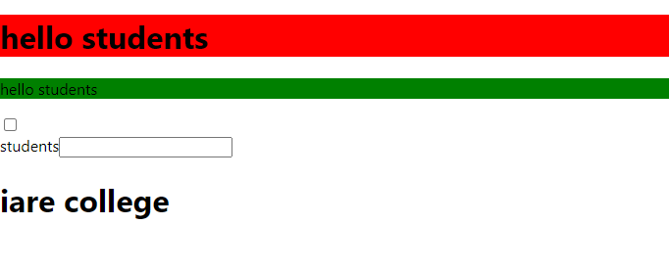
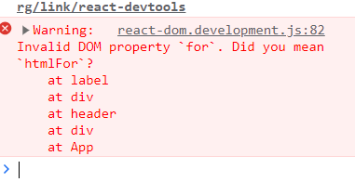
JSX attributes and Expresions
Index.js
import React from 'react';
import ReactDOM from 'react-dom/client';
import App from './App'
let root=ReactDOM.createRoot(document.getElementById('root'));
root.render(<App />
);

Slide 66
JSX attributes and Expresions
Header.js
import './index.css'
function header()
{
return(
<div>
<h1 id='name' >hello students</h1>
<p className='name1'>hello students</p>
<input type="checkbox" id="sub" /><br/>
<label htmlFor="sub">students</label>
<input type="text"/>
</div>
)
}
export default header

Slide 67
JSX attributes and Expresions
App.js
import Header from './header'
function App()
{
return(
<div>
<Header/>
<h1>iare college</h1>
</div>
)
}
export default App

Slide 68
JSX attributes and Expresions
Index.js
import React from 'react';
import ReactDOM from 'react-dom/client';
import App from './App'
let root=ReactDOM.createRoot(document.getElementById('root'));
root.render(<App />
);
}

Slide 69
JSX attributes and Expresions
Using JavaScript expressions in JSX: In React we are allowed to use normal JavaScript expressions with JSX. To embed any JavaScript expression in a piece of code written in JSX we will have to wrap that expression in curly braces {}.

Slide 70
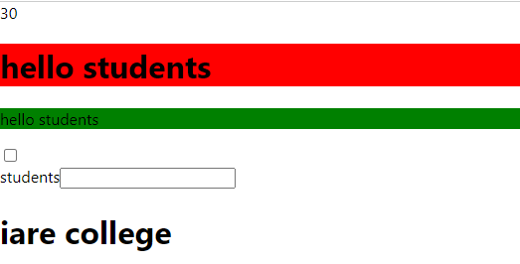
JSX attributes and Expresions
Header.js
import './index.css'
function header()
{
return(
<div>
{5*6}
<h1 id='name' >hello students</h1>
<p className='name1'>hello students</p>
<input type="checkbox" id="sub" /><br/>
<label htmlFor="sub">students</label>
<input type="text"/>
</div>
)
}
export default header

Slide 71
JSX attributes and Expresions
App.js
import Header from './header'
function App()
{
return(
<div>
<Header/>
<h1>iare college</h1>
</div>
)
}
export default App

Slide 72
JSX attributes and Expresions
Index.js
import React from 'react';
import ReactDOM from 'react-dom/client';
import App from './App'
let root=ReactDOM.createRoot(document.getElementById('root'));
root.render(<App />
);
}

Slide 73
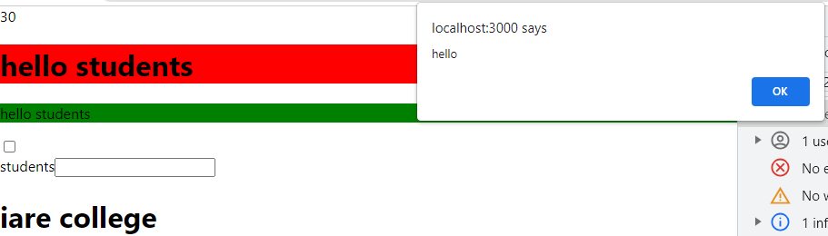
JSX attributes and Expresions
Header.js
import './index.css'
function header()
{
return(
<div>
{5*6}
{alert("hello")}
<h1 id='name' >hello students</h1>
<p className='name1'>hello students</p>
<input type="checkbox" id="sub" /><br/>
<label htmlFor="sub">students</label>
<input type="text"/>
</div>
)
}
export default header

Slide 74
JSX attributes and Expresions
App.js
import Header from './header'
function App()
{
return(
<div>
<Header/>
<h1>iare college</h1>
</div>
)
}
export default App

Slide 75
JSX attributes and Expresions
Index.js
import React from 'react';
import ReactDOM from 'react-dom/client';
import App from './App'
let root=ReactDOM.createRoot(document.getElementById('root'));
root.render(<App />
);
}

Slide 76
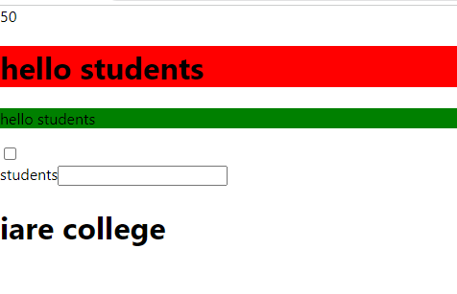
JSX attributes and Expresions
we can call functions also in the form of expressions
Header.js
import './index.css'
function header()
{
return(
<div>
{ sum(10,40)}
<h1 id='name' >hello students</h1>
<p className='name1'>hello students</p>

Slide 77
JSX attributes and Expresions
<input type="checkbox" id="sub" /><br/>
<label htmlFor="sub">students</label>
<input type="text"/>
</div>
)
}
function sum(x,y)
{
return x+y
}
export default header

Slide 78
JSX attributes and Expresions
App.js
import Header from './header'
function App()
{
return(
<div>
<Header/>
<h1>iare college</h1>
</div>
)
}
export default App

Slide 79
JSX attributes and Expresions
Index.js
import React from 'react';
import ReactDOM from 'react-dom/client';
import App from './App'
let root=ReactDOM.createRoot(document.getElementById('root'));
root.render(<App />
);
}

Slide 80
Applying styles in react(component styling)
There are many ways to style React with CSS
Inline Styling
To style an element with the inline style attribute, the value must be a JavaScript object:
App.js
function App() {
return (
<div>
<h1 style={{color: "Green"}}>Hello everyone!</h1>
<p>Here, you can find all react tutorials.</p>
</div>
);
}
export default App

Slide 81
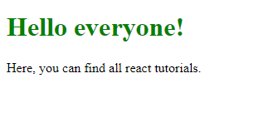
Applying styles in react(component styling)
Index.js
import React from 'react';
import ReactDOM from 'react-dom/client';
import App from './App'
let root=ReactDOM.createRoot(document.getElementById('root'));
root.render(<App />
);
Note: You can see in the above example, we have used two curly braces in: It is because, in JSX, JavaScript expressions are written inside curly braces, and JavaScript objects also use curly braces, so the above styling is written inside two sets of curly braces {{}}.

Slide 82
Applying styles in react(component styling)
camelCased Property Names
Since the inline CSS is written in a JavaScript object, properties with two names, like background-color, must be written with camel case syntax:
App.js
function App() {
return (
<div>
<h1 style={{backgroundColor: "Green"}}>Hello everyone!</h1>
<p>Here, you can find all react tutorials.</p>
</div>
);
}
export default App

Slide 83
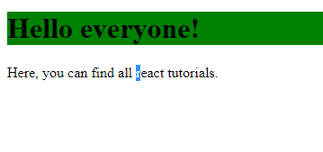
Applying styles in react(component styling)
Index.js
import React from 'react';
import ReactDOM from 'react-dom/client';
import App from './App'
let root=ReactDOM.createRoot(document.getElementById('root'));
root.render(<App />
);

Slide 84
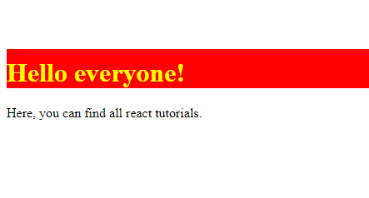
Applying styles in react(component styling)
JavaScript Object
You can also create an object with styling information, and refer to it in the style attribute:
App.js
function App() {
let s1={
backgroundColor:'Red',
color:'yellow',
marginTop:'100px',
paddingTop:'10px'
}
return (
<div>
<h1 style={s1}>Hello everyone!</h1>
<p>Here, you can find all react tutorials.</p>
</div>
)
}
export default App

Slide 85
Applying styles in react(component styling)
Index.js
import React from 'react';
import ReactDOM from 'react-dom/client';
import App from './App'
let root=ReactDOM.createRoot(document.getElementById('root'));
root.render(<App />
);
)
}
export default App

Slide 86

Applying styles in react(component styling)
CSS Stylesheet
You can write your CSS styling in a separate file, just save the file with the .css file extension, and import it in your application.
App.js
import './App.css'
function App() {
return (
<div>
<h1 className="hi">Hello everyone!</h1>
<p id="hello">Here, you can find all react tutorials.</p>
</div>
)
}
export default App

Slide 87
Applying styles in react(component styling)
App.css
#hello
{
color:aquamarine;
}
.hi
{
color:antiquewhite;
}

Slide 88
Applying styles in react(component styling)
Index.js
import React from 'react';
import ReactDOM from 'react-dom/client';
import App from './App'
let root=ReactDOM.createRoot(document.getElementById('root'));
root.render(<App />
);

Slide 89
Applying styles in react(component styling)
If u want to apply common styles for all tags available in components create one global css file in public folder
gstyle.css in public folder
h1{
background-color:red;
color:yellow;
padding-left:10px;
}

Slide 90
Applying styles in react(component styling)
Add link in index.html
html lang="en">
<head>
<link rel="stylesheet" href="./gstyle.css">
<title>React App</title>
</head>
<body>
<noscript>You need to enable JavaScript to run this app.</noscript>
<div id="root"></div>
</body>
</html>

Slide 91
Applying styles in react(component styling)
App.js function App() {
return (
<div>
<h1 className="hi">Hello everyone!</h1>
<p id="hello">Here, you can find all react tutorials.</p>
</div>
)
}
export default App

Slide 92
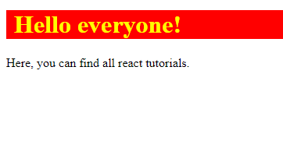
Applying styles in react(component styling)
Index.js
import React from 'react';
import ReactDOM from 'react-dom/client';
import App from './App'
let root=ReactDOM.createRoot(document.getElementById('root'));
root.render(<App />
);

Slide 93
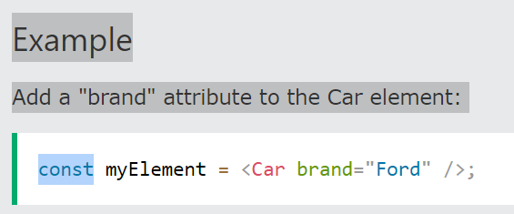
Props in reactjs
Props are arguments passed into React components.
Props are passed to components via HTML attributes.
props stands for properties.
React Props
React Props are like function arguments in JavaScript and attributes in HTML.
To send props into a component, use the same syntax as HTML attributes:

Slide 94
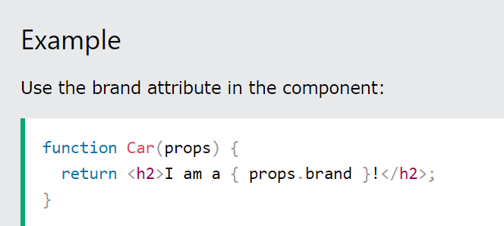
Props in reactjs
The component receives the argument as a props object:

Slide 95
Props in reactjs
Pass Data
Props are also how you pass data from one component to another, as parameters.
Create new component
User.js
function User(){
return(
<h1>nameis:john</h1>
)
}
export default User

Slide 96
Props in reactjs
App.js import User from './User'
function App()
{
return(
<User/>
)
}
export default App

Slide 97

Props in reactjs
Index.js
import React from 'react';
import ReactDOM from 'react-dom/client';
import App from './App'
let root=ReactDOM.createRoot(document.getElementById('root'));
root.render(<App />
);

Slide 98
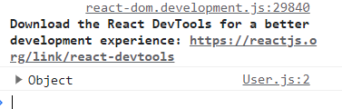
Props in reactjs
User.js
function User(props){
console.log(props)
return(
<h1>nameis:john</h1>
)
}
export default User

Slide 99
Props in reactjs
Props in functional components
User.js
function User(props){
console.log(props)
return(
<div>
<h1>nameis:{props.name}</h1>
<h1>nameis:{props.age}</h1>
</div>
)
}
export default User

Slide 100
Props in reactjs
App.js
import User from './User'
function App(){
return(
<div>
<User name='john' age='15'/>
<User name='ale' age='17'/>
</div>
)
}
export default App

Slide 101
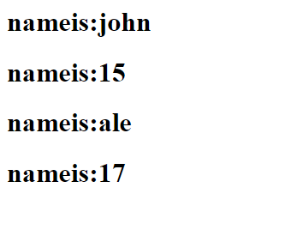
Props in reactjs
Index.js
import React from 'react';
import ReactDOM from 'react-dom/client';
import App from './App'
let root=ReactDOM.createRoot(document.getElementById('root'));
root.render(<App />
);

Slide 102
Props in reactjs
Props in class components
User.js
import React from 'react';
class User extends React.Component
{
constructor(props){
super(props);
}
render()
{
return(
<div>
<h1>name:{this.props.name}</h1>
<h1>name:{this.props.age}</h1>
</div>
)
}
}
export default User

Slide 103
Props in reactjs
App.js
import User from './User'
function App(){
return(
<div>
<User name='john' age='15'/>
<User name='ale' age='17'/>
</div>
)
}
export default App

Slide 104
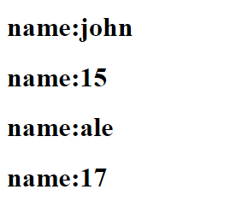
Props in reactjs
Index.js
import React from 'react';
import ReactDOM from 'react-dom/client';
import App from './App'
let root=ReactDOM.createRoot(document.getElementById('root'));
root.render(<App />
);

Slide 105
Mapmethod in reactjs
Array Methods
There are many JavaScript array methods.
One of the most useful in React is the .map() array method.
The .map() method allows you to run a function on each item in the array, returning a new array as the result.
In React, map() can be used to generate lists.

Slide 106
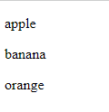
Map method in reactjs
Index.js
import React from 'react';
import ReactDOM from 'react-dom/client';
const myArray = ['apple', 'banana', 'orange'];
const myList = myArray.map((item) => <p>{item}</p>)
const container = document.getElementById('root');
const root = ReactDOM.createRoot(container);
root.render(myList);

Slide 107
Map method in reactjs
User.js
import React from 'react';
class User extends React.Component
{
constructor(props){
super(props);
}
render()
{
return(
<div>
<h1>name:{this.props.name}</h1>
<h1>age:{this.props.age}</h1>
</div>
)
}
}
export default User

Slide 108
Map method in reactjs
App.js
import User from './User'
function App(){
return(
<div>
{
[<User/>,
<User/>]
}
</div>
)
}
export default App

Slide 109
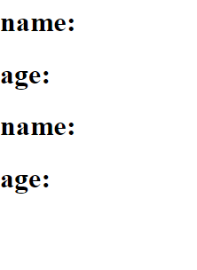
Map method in reactjs
Index.js
import React from 'react';
import ReactDOM from 'react-dom/client';
import App from './App'
let root=ReactDOM.createRoot(document.getElementById('root'));
root.render(<App />
);

Slide 110
Map method in reactjs
users.js
import React from 'react';
class User extends React.Component
{
constructor(props){
super(props);
}
render()
{
return(
<div>
<h1>id:{this.props.id}</h1>
<h1>age:{this.props.age}</h1>
</div>
)
}
}
export default User

Slide 111
Map method in reactjs
App.js
import User from './User'
function App(){
let users=[10,20,30]
return(
<div>
{
users.map(
(u)=>{
return <User id={u} />
}
)
}
</div>
)
}
export default App

Slide 112
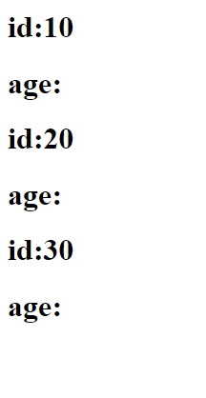
Map method in reactjs
Index.js
import React from 'react';
import ReactDOM from 'react-dom/client';
import App from './App'
let root=ReactDOM.createRoot(document.getElementById('root'));
root.render(<App />
);

Slide 113
Map method in reactjs
User.js
import React from 'react';
class User extends React.Component
{
constructor(props){
super(props);
}
render()
{
return(
<div>
<h1>id:{this.props.id}</h1>
<h1>name:{this.props.name}</h1>
<h1>age:{this.props.age}</h1>
</div>
)
}
}
export default User

Slide 114
Map method in reactjs
App.js import User from './User'
function App(){
let users=[
{id:20,
name:'ale',
age:33},
{id:21,
name:'sri',
age:50}
]

Slide 115
Map method in reactjs
return(
<div>
{
users.map(
(u)=>{
return <User key={u.id}
id={u.id} name={u.name} age={u.age} />
}
)
}
</div>
)
}
export default App

Slide 116
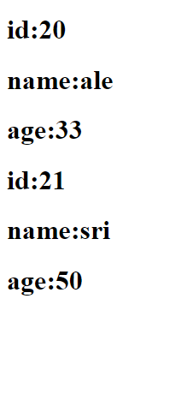
Map method in reactjs
Index.js
import React from 'react';
import ReactDOM from 'react-dom/client';
import App from './App'
let root=ReactDOM.createRoot(document.getElementById('root'));
root.render(<App />
);

Slide 117
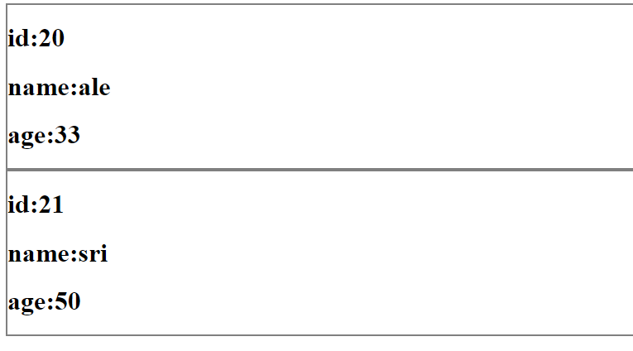
Map method in reactjs
Appling border for every user using inline css
User.js
import React from 'react';
class User extends React.Component
{
constructor(props){
super(props);
}
render()
{
return(
<div style={{border:'2px solid grey'}}>
<h1>id:{this.props.id}</h1>
<h1>name:{this.props.name}</h1>
<h1>age:{this.props.age}</h1>
</div>
)
}
}
export default User

Slide 118
Child props in reactjs
The important thing to note here is that children are a special prop that is used to pass the data from the parent component to the children component but this data must be enclosed within the parent’s opening and closing tag.
App.js
function App(props){
console.dir(props)
return(
<div>
<h1>
this is heading
</h1>
<p>this is paragraph</p>
</div>
)
}
export default App

Slide 119
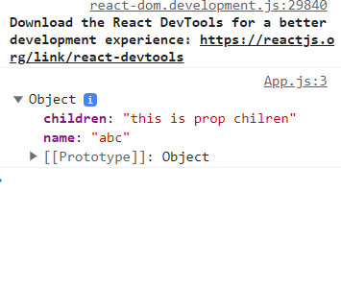
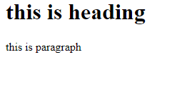
Child props in reactjs
Index.js
import React from 'react';
import ReactDOM from 'react-dom/client';
import App from './App'
let root=ReactDOM.createRoot(document.getElementById('root'));
root.render(<App name='abc’> this is prop chilren</App>)

Slide 120
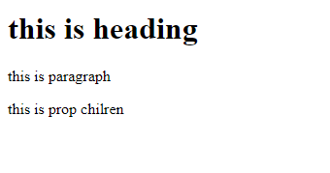
Child props in reactjs
App.js function App(props){
console.dir(props)
return(
<div>
<h1>
this is heading
</h1>
<p>this is paragraph</p>
<p>{props.children}</p>
</div>
)
}
export default App

Slide 121
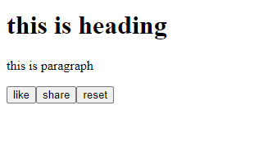
Child props in reactjs
Index.js
import React from 'react';
import ReactDOM from 'react-dom/client';
import App from './App'
let root=ReactDOM.createRoot(document.getElementById('root'));
root.render(<App name='abc'><button>like</button>
<button>share</button>
<button>reset</button>
</App>)

Slide 122
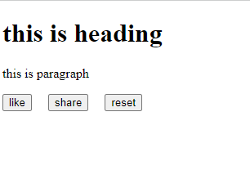
Child props in reactjs
App.js function App(props){
console.dir(props)
return(
<div>
<h1>
this is heading
</h1>
<p>this is paragraph</p>
<p style={{display:'flex', gap:'20px'}}>{props.children}</p>
</div>
)
}
export default App

Slide 123
Child props in reactjs
App.js function App(props){
console.dir(props)
return(
<div>
<h1>
this is heading
</h1>
<p>this is paragraph</p>
<p style={{display:'flex', gap:'20px'}}>{props.children}</p>
</div>
)
}
export default App

Slide 124
Child props in reactjs
Index.js
import React from 'react';
import ReactDOM from 'react-dom/client';
import App from './App'
let root=ReactDOM.createRoot(document.getElementById('root'));
root.render(<App name='abc'><button>like</button>
<button>share</button>
<button>reset</button>
</App>)

Slide 125
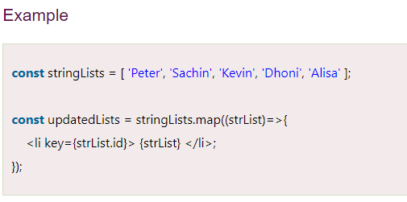
Keys in reactjs
React Keys
A key is a unique identifier. In React, it is used to identify which items have changed, updated, or deleted from the Lists. It is useful when we dynamically created components or when the users alter the lists. It also helps to determine which components in a collection needs to be re-rendered instead of re-rendering the entire set of components every time.
Keys should be given inside the array to give the elements a stable identity. The best way to pick a key as a string that uniquely identifies the items in the list. It can be understood with the below example.

Slide 126
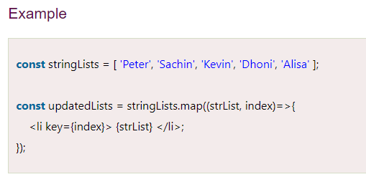

Keys in reactjs
If there are no stable IDs for rendered items, you can assign the item index as a key to the lists. It can be shown in the below example.
.

Slide 127
React fragments
React Fragment is a feature in React that allows you to return multiple elements from a React component by allowing you to group a list of children without adding extra nodes to the DOM. To return multiple elements from a React component, you'll need to wrap the element in a root element

Slide 128
React fragments
App.js
import React from "react";
function App()
{
return(
<div style={{'display':'flex' ,'gap':'20px'}}>
<FlexItems />
</div>
)}
function FlexItems(){
return(
<div>
<div>this is div1</div>
<div>this is div2</div>
<div>this is div3</div>
</div>
)
}
export default App

Slide 129
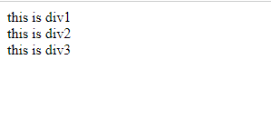
React fragments
index.js
import React from 'react';
import ReactDOM from 'react-dom/client';
import App from './App'
let ele=document.getElementById("root");
let root=ReactDOM.createRoot(ele);
root.render(<App/>);

Slide 130
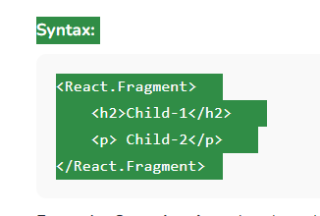
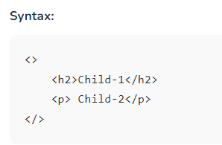
React fragments
To avoid that problem fragments were introduced
Shorthandproperty
Note: The shorthand syntax does not accept key attributes in that case you have to use the <React.Fragments> tag.

Slide 131

React fragments
<React.Fragment> tag.
import React from "react";
function App()
{
return(
<div style={{'display':'flex' ,'gap':'20px'}}>
<FlexItems />
</div>
)
}
function FlexItems(){
return(
<React.Fragment>
<div>this is div1</div>
<div>this is div2</div>
<div>this is div3</div>
</React.Fragment>
)
}
export default App

Slide 132
React fragments
App.js
import React from "react";
function App()
{
return(
<div style={{'display':'flex' ,'gap':'20px'}}>
<FlexItems />
</div>
)
}

Slide 133
React fragments
function FlexItems(){
return(
<>
<div>this is div1</div>
<div>this is div2</div>
<div>this is div3</div>
</>
)
}
export default App

Slide 134
React fragments
Index.js
import React from 'react';
import ReactDOM from 'react-dom/client';
import App from './App'
let root=ReactDOM.createRoot(document.getElementById('root'));
root.render(<App />
);

Slide 135
states
A state is an object that holds data and information related to a React component. It can be used to store, manage, and update data within the application, which in turn allows for dynamic changes to user interfaces. For example, if a button needs to change its text based on user input, then this would be done by updating the state with new values.
Additionally, components can also use their own state as well as that of other elements in order to show relevant information or respond accordingly when certain events occur. A state can be used in functional and class components, but it is more commonly used in class components. Here is an example of a class component that has a state object:

Slide 136
states
App.js
import React from 'react';
class App extends React.Component{
constructor(props)
{
super(props);
this.state={ product:"real me 8 pro",
price:30000}}
render()
{

Slide 137
states
return(
<>
<h1>product:{this.state.product}</h1>
<p>price:{this.state.price} </p>
<p>location:{this.props.location} </p>
</>
)
}}
export default App

Slide 138
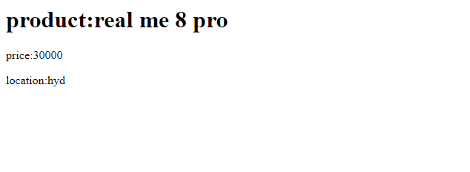
states
Index.js
import React from 'react';
import ReactDOM from 'react-dom/client';
import App from './App'
let root=ReactDOM.createRoot(document.getElementById('root'));
root.render(<App location="hyd"/>
);

Slide 139
state
App.js
import React from 'react';
class App extends React.Component{
state={
product:"real me 8 pro",
price:30000
}
render()
{
return(
<>
<h1>product:{this.state.product}</h1>
<p>price:{this.state.price} </p>
<input id='price' type='number'/>

Slide 140
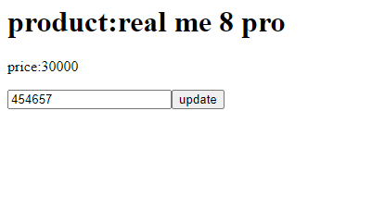
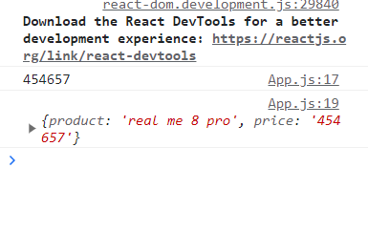
state
<button onClick={()=>{
let p=document.getElementById('price').value;
console.log(p)
this.state.price=p;
console.log(this.state)}}>
update</button>
</>
)
}
}
export default App

Slide 141
state
Index.js
import React from 'react';
import ReactDOM from 'react-dom/client';
import App from './App'
let root=ReactDOM.createRoot(document.getElementById('root'));
root.render(<App />
);

Slide 142
state
A state can be modified based on user action or network changes
Every time the state of an object changes, React re-renders the component to the browser
The state object is initialized in the constructor
The state object can store multiple properties
this.setState() is used to change the value of the state object
setState() function performs a shallow merge between the new and the previous state.

Slide 143
setState() Method
App.js
import React from 'react';
class App extends React.Component{
constructor(props)
{
super(props);
this.state={ product:"real me 8 pro",
price:30000}}
render()
{
return(
<>
<h1>product:{this.state.product}</h1>
<p>price:{this.state.price} </p>
<input id='price' type='number'/>
.

Slide 144
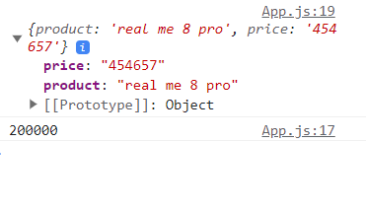
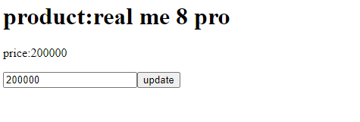
setState() Method
<button onClick={()=>{
let p=document.getElementById('price').value;
this.setState({price:p})
console.log(p)
console.log(this.state)}}>
update</button>
</>
)
}
}
export default App Note: Here setState() method is asynchronous method so in our program before updating the price state object is printed in the console.so we are getting older price every time in the state OBJECT
.

Slide 145
setState() Method
Index.js
import React from 'react';
import ReactDOM from 'react-dom/client';
import App from './App'
let root=ReactDOM.createRoot(document.getElementById('root'));
root.render(<App />
);
.

Slide 146
setState() Method
To overcome the problem we are using 2 arguments in setState method
App.js
import React from 'react';
class App extends React.Component{
constructor(props)
{
super(props);
this.state={ product:"real me 8 pro",
price:30000}}
render()
{
return(
<>
<h1>product:{this.state.product}</h1>
<p>price:{this.state.price} </p>
<input id='price' type='number'/>
.

Slide 147


setState() Method
.
<button onClick={()=>{
let p=document.getElementById('price').value;
this.setState({price:p},()=>
{
console.log(this.state);
})
}}>
update</button>
</>
)
}
}
export default App

Slide 148
setState() Method
Index.js
import React from 'react';
import ReactDOM from 'react-dom/client';
import App from './App'
let root=ReactDOM.createRoot(document.getElementById('root'));
root.render(<App />
);
.

Slide 149
setState() Method
.
App.js
inside button tag for onClick event we passing normal method without passing arrow function
import React from 'react';
class App extends React.Component{
constructor(props)
{
super(props);
this.state={ product:"real me 8 pro",
price:30000}
this.updatePrice=this.updatePrice.bind(this)}
render()
{
return(
<>
<h1>product:{this.state.product}</h1>
<p>price:{this.state.price} </p>
<input id='price' type='number'/>

Slide 150
setState() Method
<button onClick={this.updatePrice}>update</button>
</>
)
}
updatePrice(){
let p=document.getElementById('price').value;
this.setState({price:p},()=>
{
console.log(this.state);
})
}
}
export default App
.

Slide 151
setState() Method
Index.js
import React from 'react';
import ReactDOM from 'react-dom/client';
import App from './App'
let root=ReactDOM.createRoot(document.getElementById('root'));
root.render(<App />
);
.

Slide 152
React lifecycle methods
In React, components have a lifecycle that consists of different phases. Each phase has a set of lifecycle methods that are called at specific points in the component's lifecycle. These methods allow you to control the component's behavior and perform specific actions at different stages of its lifecycle.
A component's lifecycle has three main phases:
Mounting Phase
Updating Phase
Unmounting Phase
The Mounting Phase begins when a component is first created and inserted into the DOM. The Updating Phase occurs when a component's state or props change. And the Unmounting Phase occurs when a component is removed from the DOM.

Slide 153

React lifecycle methods
Mounting phase
Mounting means putting elements into the DOM.
React has four built-in methods that gets called, in this order, when mounting a component:
Constructor()
get DerivedStateFromProps()
render()
componentDidMount()
Component Mounting Phase

Slide 154
React lifecycle methods
Component Mounting Phase
The constructor() lifecycle method
The constructor() method is called when the component is first created. You use it to initialize the component's state and bind methods to the component's instance.
Render()
The render() method is required, and is the method that actually outputs the HTML to the DOM.

Slide 155

React lifecycle methods
Index.js(example for constructor())
import React from 'react';
import ReactDOM from 'react-dom/client';
class Header extends React.Component {
constructor(props) {
super(props);
this.state = {favoritecolor: "red"};
}
render() {
return (
<h1>My Favorite Color is {this.state.favoritecolor}</h1>
);
}
}
const root = ReactDOM.createRoot(document.getElementById('root'));
root.render(<Header />);
Component Mounting Phase

Slide 156

React lifecycle methods
Index.js(example for render())
import React from 'react';
import ReactDOM from 'react-dom/client';
class Header extends React.Component {
render() {
return (
<h1>This is the content of the Header component</h1>
);
}
}
const root = ReactDOM.createRoot(document.getElementById('root'));
root.render(<Header />);
Component Mounting Phase

Slide 157
React lifecycle methods
The getDerivedStateFromProps() lifecycle method
The getDerivedStateFromProps() method is called right before rendering the element(s) in the DOM.
This is the natural place to set the state object based on the initial props.
It takes state as an argument, and returns an object with changes to the state.
Component Mounting Phase

Slide 158
React lifecycle methods
Index.js
import React from 'react';
import ReactDOM from 'react-dom/client';
class Header extends React.Component {
constructor(props) {
super(props);
this.state = {favoritecolor: "red"};
}
static getDerivedStateFromProps(props, state) {
return {favoritecolor: props.favcol };
}
render() {
return (
<h1>My Favorite Color is {this.state.favoritecolor}</h1>
);
}
}
Component Mounting Phase

Slide 159

React lifecycle methods
const root = ReactDOM.createRoot(document.getElementById('root'));
root.render(<Header favcol="yellow"/>);
Component Mounting Phase

Slide 160
React lifecycle methods
The componentDidMount() lifecycle method
The componentDidMount() method is called after the component is rendered.
This is where you run statements that requires that the component is already placed in the DOM.
Component Mounting Phase

Slide 161
React lifecycle methods
Index.js
import React from 'react';
import ReactDOM from 'react-dom/client';
class Header extends React.Component {
constructor(props) {
super(props);
this.state = {favoritecolor: "red"};
}
componentDidMount() {
setTimeout(() => {
this.setState({favoritecolor: "yellow"})
}, 1000)
}
Component Mounting Phase

Slide 162

React lifecycle methods
render() {
return (
<h1>My Favorite Color is {this.state.favoritecolor}</h1>
);
}
}
const root = ReactDOM.createRoot(document.getElementById('root'));
root.render(<Header />);
Component Mounting Phase

Slide 163
React lifecycle methods
Component Updating Phase
This phase occurs when a component's props or state changes, and the component needs to be updated in the DOM.
Lifecycle methods
get DerivedStateFromProps()
shouldComponentUpdate()
render()
getSnapshotBeforeUpdate()
componentDidUpdate()
get DerivedStateFromProps()
Also at updates the getDerivedStateFromProps method is called. This is the first method that is called when a component gets updated.
This is still the natural place to set the state object based on the initial props.
Component Mounting Phase

Slide 164
React lifecycle methods
Index.js
import React from 'react';
import ReactDOM from 'react-dom/client';
class Header extends React.Component {
constructor(props) {
super(props);
this.state = {favoritecolor: "red"};
}
static getDerivedStateFromProps(props, state) {
return {favoritecolor: props.favcol };
}

Slide 165

React lifecycle methods
changeColor = () => {
this.setState({favoritecolor: "blue"});
}
render() {
return (
<div>
<h1>My Favorite Color is {this.state.favoritecolor}</h1>
<button type="button" onClick={this.changeColor}>Change color</button>
</div>
);
}
}

Slide 166
React lifecycle methods
const root = ReactDOM.createRoot(document.getElementById('root'));
root.render(<Header favcol="yellow" />);

Slide 167
React lifecycle methods
The shouldComponentUpdate() lifecycle method
In the shouldComponentUpdate() method you can return a Boolean value that specifies whether React should continue with the rendering or not.
The default value is true.
Index.js
import React from 'react';
import ReactDOM from 'react-dom/client';
class Header extends React.Component {
constructor(props) {
super(props);
this.state = {favoritecolor: "red"};
}
shouldComponentUpdate() {
return false;
}
Component Mounting Phase

Slide 168

React lifecycle methods
Component Mounting Phase
changeColor = () => {
this.setState({favoritecolor: "blue"});
}
render() {
return (
<div>
<h1>My Favorite Color is {this.state.favoritecolor}</h1>
<button type="button" onClick={this.changeColor}>Change color</button>
</div>
);
}
}
const root = ReactDOM.createRoot(document.getElementById('root'));
root.render(<Header />);

Slide 169
React lifecycle methods
render()
The render() method is of course called when a component gets updated, it has to re-render the HTML to the DOM, with the new changes.
getSnapshotBeforeUpdate()
In the getSnapshotBeforeUpdate() method you have access to the props and state before the update, meaning that even after the update, you can check what the values were before the update.
If the getSnapshotBeforeUpdate() method is present, you should also include the componentDidUpdate() method, otherwise you will get an error.

Slide 170
React lifecycle methods
Index.js
class Header extends React.Component {
constructor(props) {
super(props);
this.state = {favoritecolor: "red"};
}
componentDidMount() {
setTimeout(() => {
this.setState({favoritecolor: "yellow"})
}, 1000)
}
getSnapshotBeforeUpdate(prevProps, prevState) {
document.getElementById("div1").innerHTML =
"Before the update, the favorite was " + prevState.favoritecolor;
}
Component Mounting Phase

Slide 171

React lifecycle methods
componentDidUpdate() {
document.getElementById("div2").innerHTML =
"The updated favorite is " + this.state.favoritecolor;
}
render() {
return (
<div>
<h1>My Favorite Color is {this.state.favoritecolor}</h1>
<div id="div1"></div>
<div id="div2"></div>
</div>
);
}
}
const root = ReactDOM.createRoot(document.getElementById('root'));
root.render(<Header />);
Component Mounting Phase

Slide 172


React lifecycle methods
The componentDidUpdate lifecycle method
The componentDidUpdate() method is a lifecycle method in React that is called after a component has been updated and re-rendered. It is useful for performing side effects or additional operations when the component's props or state have changed.
Component Mounting Phase

Slide 173

React lifecycle methods
Index.js
import React from 'react';
import ReactDOM from 'react-dom/client';
class Header extends React.Component {
constructor(props) {
super(props);
this.state = {favoritecolor: "red"};
}
componentDidMount() {
setTimeout(() => {
this.setState({favoritecolor: "yellow"})
}, 1000)
}
Component Mounting Phase

Slide 174
React lifecycle methods
componentDidUpdate() {
document.getElementById("mydiv").innerHTML =
"The updated favorite is " + this.state.favoritecolor;
}
render() {
return (
<div>
<h1>My Favorite Color is {this.state.favoritecolor}</h1>
<div id="mydiv"></div>
</div>
);
}
}
const root = ReactDOM.createRoot(document.getElementById('root'));
root.render(<Header />);
Component Mounting Phase

Slide 175
React lifecycle methods
Unmounting
The next phase in the lifecycle is when a component is removed from the DOM, or unmounting as React likes to call it.
React has only one built-in method that gets called when a component is unmounted:
componentWillUnmount()
The componentWillUnmount method is called when the component is about to be removed from the DOM.
Component Mounting Phase

Slide 176
React lifecycle methods
Index.js
import React from 'react';
import ReactDOM from 'react-dom/client';
class Container extends React.Component {
constructor(props) {
super(props);
this.state = {show: true};
}
delHeader = () => {
this.setState({show: false});
}
render() {
let myheader;
if (this.state.show) {
myheader = <Child />;
};
Component Mounting Phase

Slide 177
React lifecycle methods
return (
<div>
{myheader}
<button type="button" onClick={this.delHeader}>Delete Header</button>
</div>
);
}
}
class Child extends React.Component {
componentWillUnmount() {
alert("The component named Header is about to be unmounted.");
}
Component Mounting Phase

Slide 178


React lifecycle methods
render() {
return (
<h1>Hello World!</h1>
);
}
}
const root = ReactDOM.createRoot(document.getElementById('root'));
root.render(<Container />);
Component Mounting Phase

Slide 179
Hooks
Hooks were added to React in version 16.8.
Hooks allow function components to have access to state and other React features. Because of this, class components are generally no longer needed
What is a Hook?
Hooks allow us to "hook" into React features such as state and lifecycle methods.
You must import Hooks from react.
Here we are using the useState Hook to keep track of the application state.
State generally refers to application data or properties that need to be tracked.
Component Mounting Phase

Slide 180
Hooks
Hook Rules
There are 3 rules for hooks:
Hooks can only be called inside React function components.
Hooks can only be called at the top level of a component.
Hooks cannot be conditional.
Note: Hooks will not work in React class components.
Component Mounting Phase

Slide 181

Hooks
The React useState Hook allows us to track state in a function component.
State generally refers to data or properties that need to be tracking in an application.
Import useState
To use the useState Hook, we first need to import it into our component.
Component Mounting Phase

Slide 182

Hooks
Initialize useState
We initialize our state by calling useState in our function component.
useState accepts an initial state and returns two values:
The current state.
A function that updates the state.
Component Mounting Phase

Slide 183
Hooks
we are destructuring the returned values from useState.
The first value, color, is our current state.
The second value, setColor, is the function that is used to update our state.
we set the initial state to an empty string: useState(“ ")
Component Mounting Phase

Slide 184

Hooks
Index.js
import { useState } from "react";
import ReactDOM from "react-dom/client";
function FavoriteColor() {
const [color, setColor] = useState("red");
return <h1>My favorite color is {color}!</h1>
}
const root = ReactDOM.createRoot(document.getElementById('root'));
root.render(<FavoriteColor />);
Component Mounting Phase

Slide 185
Hooks
Update State
Index.js
import { useState } from "react";
import ReactDOM from "react-dom/client";
function FavoriteColor() {
const [color, setColor] = useState("red");
return (
<>
<h1>My favorite color is {color}!</h1>
<button
type="button"
onClick={() => setColor("blue")}
>Blue</button>
</>
)
}
Component Mounting Phase

Slide 186

Hooks
const root = ReactDOM.createRoot(document.getElementById('root'));
root.render(<FavoriteColor />);
Component Mounting Phase

Slide 187
Hooks
What Can State Hold
The useState Hook can be used to keep track of strings, numbers, booleans, arrays, objects, and any combination of these!
Index.js
import { useState } from "react";
import ReactDOM from "react-dom/client";
function Car() {
const [brand, setBrand] = useState("Ford");
const [model, setModel] = useState("Mustang");
const [year, setYear] = useState("1964");
const [color, setColor] = useState("red");
Component Mounting Phase

Slide 188
Hooks
What Can State Hold
The useState Hook can be used to keep track of strings, numbers, booleans, arrays, objects, and any combination of these!
Index.js
import { useState } from "react";
import ReactDOM from "react-dom/client";
function Car() {
const [brand, setBrand] = useState("Ford");
const [model, setModel] = useState("Mustang");
const [year, setYear] = useState("1964");
const [color, setColor] = useState("red");
Component Mounting Phase

Slide 189

Hooks
return (
<>
<h1>My {brand}</h1>
<p>
It is a {color} {model} from {year}.
</p>
</>
)
}
const root = ReactDOM.createRoot(document.getElementById('root'));
root.render(<Car />);
Component Mounting Phase

Slide 190
Hooks
we can just use one state and include an object instead!
Index.js
import { useState } from "react";
import ReactDOM from "react-dom/client";
function Car() {
const [car, setCar] = useState({
brand: "Ford",
model: "Mustang",
year: "1964",
color: "red"
});
Component Mounting Phase

Slide 191
Hooks
return (
<>
<h1>My {car.brand}</h1>
<p>
It is a {car.color} {car.model} from {car.year}.
</p>
</>
)
}
const root = ReactDOM.createRoot(document.getElementById('root'));
root.render(<Car />);
Component Mounting Phase

Slide 192

Hooks
Updating Objects and Arrays in State
When state is updated, the entire state gets overwritten.
What if we only want to update the color of our car?
If we only called setCar({color: "blue"}), this would remove the brand, model, and year from our state.
Component Mounting Phase

Slide 193
Hooks
Index.js
import { useState } from "react";
import ReactDOM from "react-dom/client";
function Car() {
const [car, setCar] = useState({
brand: "Ford",
model: "Mustang",
year: "1964",
color: "red"
});
const updateColor = () => {
setCar(previousState => {
return { ...previousState, color: "blue" }
});
}
Component Mounting Phase

Slide 194

Hooks
return (
<>
<h1>My {car.brand}</h1>
<p>
It is a {car.color} {car.model} from {car.year}.
</p>
<button
type="button"
onClick={updateColor}
>Blue</button>
</>
)
}
const root = ReactDOM.createRoot(document.getElementById('root'));
root.render(<Car />);
Component Mounting Phase

Slide 195



hooks
import React from "react"
function App() {
let counter=0
return(
<>
<h1>Counter Value:{counter} </h1>
<button onClick={updateCounter}> Change</button>
</>
)
function updateCounter(){
++counter;
console.log(counter)
}}
export default App

Slide 196

hooks
import React,{useState} from "react"
function App() {
let [counter,updateCounter]= useState(0)
return(
<>
<h1>Counter Value:{counter} </h1>
<button onClick={()=> {
updateCounter(++counter)
}}>Change</button>
</>
)
}
export default App

Slide 197


states
import React from "react"
class App extends React.Component{
state={counter:0}
render(){
return(
<>
<h1>Counter Value:{this.state.counter} </h1>
<button onClick={()=>{this.setState({counter:this.state.counter+1})
}}>Change</button>
</>)
}}
export default App

Slide 198
Conditional rendering
In React, you can conditionally render components.
There are several ways to do this.
if Statement
We can use the if JavaScript operator to decide which component to render.
Component Mounting Phase

Slide 199
Conditional rendering
App.js
function MissedGoal() {
return <h1>MISSED!</h1>;
}
function MadeGoal() {
return <h1>GOAL!</h1>;
}
function Goal(props) {
const isGoal = props.isGoal;
if (isGoal) {
return <MadeGoal/>;
}
return <MissedGoal/>;
}
export default Goal
`
Component Mounting Phase

Slide 200

Conditional rendering
`
Component Mounting Phase
Index.js
import React from 'react';
import ReactDOM from 'react-dom/client';
import Goal from './App';
const root = ReactDOM.createRoot(document.getElementById('root'));
root.render(<Goal isGoal={true}/>
)

Slide 201
Conditional rendering
`
Logical && Operator
Another way to conditionally render a React component is by using the && operator.
App.js
function Garage(props) {
const cars = props.cars;
return (
<>
<h1>Garage</h1>
{cars.length > 0 &&
<h2>
You have {cars.length} cars in your garage.
</h2>
}
</>
);
}
export default Garage
Component Mounting Phase

Slide 202

Conditional rendering
`
Index.js
import React from 'react';
import ReactDOM from 'react-dom/client';
import Garage from './App';
const root = ReactDOM.createRoot(document.getElementById('root'));
const cars = ['Ford', 'BMW', 'Audi','maruthi'];
root.render(<Garage cars={cars} />
)
Component Mounting Phase

Slide 203

Conditional rendering
`
Component Mounting Phase
Ternary Operator
Another way to conditionally render elements is by using a ternary operator.
App.js
function MissedGoal() {
return <h1>MISSED!</h1>;
}
function MadeGoal() {
return <h1>Goal!</h1>;
}
x

Slide 204
Conditional rendering
function Goal(props) {
const isGoal = props.isGoal;
return (
<>
{ isGoal ? <MadeGoal/> : <MissedGoal/> }
</>
);
}
export default Goal
`
Component Mounting Phase

Slide 205

Conditional rendering
Index.js
import React from 'react';
import ReactDOM from 'react-dom/client';
import Goal from './App';
const root = ReactDOM.createRoot(document.getElementById('root'));
root.render(<Goal isGoal={false}/>
)
`
Component Mounting Phase

Slide 206
Event handling
Just like HTML DOM events, React can perform actions based on user events.
React has the same events as HTML: click, change, mouseover etc.
`
Component Mounting Phase

Slide 207

Event handling
Adding Events
React events are written in camelCase syntax:
onClick instead of onclick.
React event handlers are written inside curly braces:
onClick={shoot} instead of onClick="shoot()".
`
Component Mounting Phase

Slide 208


Event handling
Index.js
import React from 'react';
import ReactDOM from 'react-dom/client';
function Football() {
const shoot = () => {
alert("Great Shot!");
}
return (
<button onClick={shoot}>Take the shot!</button>
);
}
const root = ReactDOM.createRoot(document.getElementById('root'));
root.render(<Football />);
`
Component Mounting Phase

Slide 209


Event handling
Passing Arguments
To pass an argument to an event handler, use an arrow function.
Index.js
function Football() {
const shoot = (a) => {
alert(a);
}
return (
<button onClick={() => shoot("Goal!")}>Take the shot!</button>
);
}
const root = ReactDOM.createRoot(document.getElementById('root'));
root.render(<Football />);
`
Component Mounting Phase

Slide 210
Event handling
`
Component Mounting Phase
React Event Object
Event handlers have access to the React event that triggered the function.
In our example the event is the "click" event.

Slide 211

Event handling
`
Component Mounting Phase
Index.js
import React from 'react';
import ReactDOM from 'react-dom/client';
function Football() {
const shoot = (a, b) => {
alert(b.type);
/*
'b' represents the React event that triggered the function.In this case, the 'click' event */
}
return (
<button onClick={(event) => shoot("Goal!", event)}>Take the shot!</button>
);
}
const root = ReactDOM.createRoot(document.getElementById('root'));
root.render(<Football />);

Slide 212




Routing in react
React Router
is a standard library for routing in React. It enables the navigation among views of various components in a React Application, allows changing the browser URL, and keeps the UI in sync with the URL.
Setting up the React Application: Create a React application using create-react-app
Install router library
npm install react-router-dom
After executing this command check package.json file
After installing react-router-dom, add its components to your React application.
`
Component Mounting Phase

Slide 213
Routing in react
`
Component Mounting Phase
Configure Routes
<BrowserRouter>
<Routes>
<Route exact path="/" element={<Home />} /
<Route path="/about" element={<About />} /
<Route path="/contact" element={<Contact /
</Routes>
</Browser Router>
To add React Router components in your application, open your project directory in the editor you use and go to app.js file. Now, add the below given code in app.js.
import { BrowserRouter , Routes, Route, Link } from 'react-router-dom';

Slide 214
Routing in react
About.js
function About(){
return(
<div>about component</div>
)
}
export default About
Contact.js
function Contact(){
return(
<div>contact component</div>
)
}
export default Contact
`
Component Mounting Phase

Slide 215
Routing in react
Login.js
function Login(){
return(
<div>Login component</div>
)
}
export default Login
Home.js
function Home(){
return(
<div>home component</div>
)
}
export default Home
`
Component Mounting Phase

Slide 216
Routing in react
App.js
import Home from './Home'
import About from './About'
import Contact from './Contact'
import Login from './Login'
import { BrowserRouter , Routes, Route, Link } from 'react-router-dom';
function App()
{
return(
<>
<div>App component</div>
`
Component Mounting Phase

Slide 217
Routing in react
<BrowserRouter>
<Routes>
<Route exact path="/" element={<Home />}/>
<Route path="/about" element={<About />}/>
<Route path="/contact" element={<Contact/>}/>
<Route path="/Login" element={<Login/>}/>
</Routes>
</BrowserRouter>
</>
)
}
export default App
`
Component Mounting Phase

Slide 218

Routing in react
Index.js
import React from 'react';
import ReactDOM from 'react-dom/client';
import App from './App'
let root=ReactDOM.createRoot(document.getElementById('root'));
root.render(<App/>)
`
Component Mounting Phase

Slide 219
Routing in react
Create Navigation Links
<Link to="/">Home</Link>
<Link to="/about">About</Link>
<Link to="/contact">Contact Us</Link>
`
Component Mounting Phase

Slide 220
Routing in react
App.js
import Home from './Home'
import About from './About'
import Contact from './Contact'
import Login from './Login'
import { BrowserRouter , Routes, Route, Link } from 'react-router-dom';
function Header()
{
return(
<ul>
<li><Link to="/">Home</Link></li>
<li> <Link to="/about">About</Link></li>
<li><Link to="/contact">Contact Us</Link></li>
<li><Link to="/Login">login</Link></li>
</ul>
)
}
`
Component Mounting Phase

Slide 221
Routing in react
function App()
{
return(
<>
<BrowserRouter>
<Header/>
<Routes>
<Route exact path="/" element={<Home />}/>
<Route path="/about" element={<About />}/>
<Route path="/contact" element={<Contact/>}/>
<Route path="/Login" element={<Login/>}/>
</Routes>
</BrowserRouter>
</>
)
}
export default App
`
Component Mounting Phase

Slide 222

Routing in react
`
Index.js
import React from 'react';
import ReactDOM from 'react-dom/client';
import App from './App'
let root=ReactDOM.createRoot(document.getElementById('root'));
root.render(<App/>)
Component Mounting Phase

Slide 223
Routing in react
Nested routing
Login.js
import {Outlet} from 'react-router-dom'
function Login(){
return(<>
<h1>Login component</h1>
<Outlet/></>)
}
export function Signin(){
return(
<h1>signin component</h1>
)
}
`
Component Mounting Phase

Slide 224
Routing in react
export function Signout(){
return(
<h1>signout component</h1>
)
}
export default Login
`
Component Mounting Phase

Slide 225
Routing in react
App.js
import Home from './Home'
import About from './About'
import Contact from './Contact'
import Login,{Signin,Signout} from './Login'
import { BrowserRouter , Routes, Route, Link } from 'react-router-dom';
function Header()
{
return(
<ul>
<li><Link to="/">Home</Link></li>
<li> <Link to="/about">About</Link></li>
<li><Link to="/contact">Contact Us</Link></li>
<li><Link to="/Login">login</Link></li>
</ul>
`
Component Mounting Phase

Slide 226
Routing in react
)}
function App()
{
return(
<>
<BrowserRouter>
<Header/>
<Routes>
<Route path="/" element={<Home/>}/>
<Route path="about" element={<About/>}/>
<Route path="contact" element={<Contact/>}/>
<Route path="Login" element={<Login/>}>
<Route path="Signin" element={<Signin/>}/>
<Route path="Signout" element={<Signout/>}/>
</Route>
</Routes> </BrowserRouter>
</> ) }
export default App
`
Component Mounting Phase

Slide 227

Routing in react
Index.js
import React from 'react';
import ReactDOM from 'react-dom/client';
import App from './App'
let root=ReactDOM.createRoot(document.getElementById('root'));
root.render(<App/>)
`
Component Mounting Phase

Slide 228
Routing in react
Login.js
import {Outlet} from 'react-router-dom'
import {Link} from 'react-router-dom'
function Login(){
return<>
<div>
<button><Link to="Signin">Signin</Link></button>
<button><Link to="Signout">Signout</Link></button>
</div>
<h1>Login component</h1>
<Outlet/></>
}
`
Component Mounting Phase

Slide 229
Routing in react
export function Signin(){
return(
<h1>signin component</h1>
)
}
export function Signout(){
return(
<h1>signout component</h1>
)
}
export default Login
`
Component Mounting Phase

Slide 230
Routing in react
App.js
import Home from './Home'
import About from './About'
import Contact from './Contact'
import Login,{Signin,Signout} from './Login'
import { BrowserRouter , Routes, Route, Link } from 'react-router-dom';
function Header()
{
return(
<ul>
<li>
<Link to="/">Home</Link>
</li>
`
Component Mounting Phase

Slide 231
Routing in react
<li> <Link to="/about">About</Link></li>
<li><Link to="/contact">Contact Us</Link></li>
<li><Link to="/Login">login</Link></li>
</ul>
)
}
function App()
{
return(
<>
<BrowserRouter>
<Header/>
<Routes>
<Route path="/" element={<Home/>}/>
<Route path="about" element={<About/>}/>
<Route path="contact" element={<Contact/>}/>
`
Component Mounting Phase

Slide 232
Routing in react
<Route path="Login" element={<Login/>}>
<Route path="Signin" element={<Signin/>}/>
<Route path="Signout" element={<Signout/>}/>
</Route>
</Routes>
</BrowserRouter>
</>
)
}
export default App
`
Component Mounting Phase

Slide 233

Routing in react
`
Index.js
import React from 'react';
import ReactDOM from 'react-dom/client';
import App from './App'
let root=ReactDOM.createRoot(document.getElementById('root'));
root.render(<App/>)
Component Mounting Phase

Slide 234
Routing in react
`
App.css ul{
background-color:red;
}
button{
background-color:blue;
margin:5px;
}
Component Mounting Phase

Slide 235
Routing in react
App.js import Home from './Home'
import About from './About'
import Contact from './Contact'
import Login,{Signin,Signout} from './Login'
import './App.css'
import { BrowserRouter , Routes, Route, Link } from 'react-router-dom';
function Header()
{
return(
<ul style={{display:'flex',gap:'20px',listStyleType:'none'}}>
`
Component Mounting Phase

Slide 236
Routing in react
<li>
<Link style={{textDecoration:'none'}} to="/">Home</Link>
</li>
<li> <Link style={{textDecoration:'none'}} to="/about">About</Link></li>
<li><Link style={{textDecoration:'none'}} to="/contact">Contact Us</Link></li>
<li><Link style={{textDecoration:'none'}} to="/Login">login</Link></li>
</ul>
)
}
function App()
{
return(
<>
`
Component Mounting Phase

Slide 237
Routing in react
<BrowserRouter>
<Header/>
<Routes>
<Route path="/" element={<Home/>}/>
<Route path="about" element={<About/>}/>
<Route path="contact" element={<Contact/>}/>
<Route path="Login" element={<Login/>}>
<Route path="Signin" element={<Signin/>}/>
<Route path="Signout" element={<Signout/>}/>
</Route>
</Routes>
</BrowserRouter>
</>
)
}
export default App
`
Component Mounting Phase

Slide 238
Routing in react
Login.js
import {Outlet} from 'react-router-dom'
import {Link} from 'react-router-dom'
function Login(){
return<>
<div>
<button><Link to="Signin">Signin</Link></button>
<button><Link to="Signout">Signout</Link></button>
</div>
<h1>Login component</h1>
<Outlet/></>
}
`
Component Mounting Phase

Slide 239
Routing in react
export function Signin(){
return(
<h1>signin component</h1>
)
}
export function Signout(){
return(
<h1>signout component</h1>
)
}
export default Login
`
Component Mounting Phase

Slide 240
Routing in react
Contact.js
function Contact(){
return(
<div>contact component</div>
)
}
export default Contact
`
Component Mounting Phase

Slide 241
Routing in react
Home.js
function Home(){
return(
<div>home component</div>
)
}
export default Home
About.js
function About(){
return(
<div>about component</div>
)
}
export default About
`
Component Mounting Phase

Slide 242

Routing in react
Index.js
import React from 'react';
import ReactDOM from 'react-dom/client';
import App from './App'
let root=ReactDOM.createRoot(document.getElementById('root'));
root.render(<App/>)
`
Component Mounting Phase

Slide 243

React Forms
Just like in HTML, React uses forms to allow users to interact with the web page.
Adding Forms in React
You add a form with React like any other element:
Example: Add a form that allows users to enter their name:
Index.js
import React from 'react';
import ReactDOM from 'react-dom/client';
function MyForm() {
return (
<form>
<label>Enter your name:<input type="text" /></label>
</form>
)}
const root = ReactDOM.createRoot(document.getElementById('root'));
root.render(<MyForm />);
Component Mounting Phase

Slide 244
Handling Forms
Handling forms is about how you handle the data when it changes value or gets submitted.
In HTML, form data is usually handled by the DOM.
In React, form data is usually handled by the components.
When the data is handled by the components, all the data is stored in the component state.
You can control changes by adding event handlers in the onChange attribute.
We can use the useState Hook to keep track of each inputs value and provide a "single source of truth" for the entire application.ponent Mounting Phase

Slide 245
Handling Forms
Index.js
import React from 'react';
import ReactDOM from 'react-dom/client';
import {useState}from 'react'
function App()
{
const[email,setEmail]=useState("")
return(
<>
<label>email</label>
<input type='email'/>
</>
)
}

Slide 246

Handling Forms
let root=ReactDOM.createRoot(document.getElementById('root'));
root.render(<App/>)

Slide 247
Handling Forms
Index.js
import React from 'react';
import ReactDOM from 'react-dom/client';
import {useState}from 'react'
function App()
{
const[email,setEmail]=useState("")
return(
<>
<div>
<label>email</label>
<input type='email' value={email}/>
</div>
</>
)
}

Slide 248

Handling Forms
let root=ReactDOM.createRoot(document.getElementById('root'));
root.render(<App/>)

Slide 249
Handling Forms
Index.js
import { useState } from 'react';
import ReactDOM from 'react-dom/client';
function MyForm() {
const [name, setName] = useState("");
return (
<form>
<label>Enter your name:
<input
type="text"
value={name}
onChange={(e) => setName(e.target.value)}
/>
</label>

Slide 250

Handling Forms
</form>
)
}
const root = ReactDOM.createRoot(document.getElementById('root'));
root.render(<MyForm />);

Slide 251
Multiple Input Fields
You can control the values of more than one input field by adding a name attribute to each element.
We will initialize our state with an empty object.
To access the fields in the event handler use the event.target.name and event.target.value syntax.
To update the state, use square brackets [bracket notation] around the property name.
Component Mounting Phase

Slide 252
Multiple Input Fields
import { useState } from "react";
import ReactDOM from "react-dom/client";
function MyForm() {
const [inputs, setInputs] = useState({});
const handleChange = (event) => {
const newobj={...inputs,[event.target.name]:event.target.value}
setInputs(newobj)
}
const handleSubmit = (event) => {
event.preventDefault();
console.log(inputs);
}
Component Mounting Phase

Slide 253

Multiple Input Fields
return (
<form onSubmit={handleSubmit}>
<label>Enter your name:
<input type="text" name="username“ onChange={handleChange} /> </label>
<label>Enter your age:
<input type="number" name="age" onChange={handleChange} /></label>
<input type="submit" />
</form>
)}
const root = ReactDOM.createRoot(document.getElementById('root'));
root.render(<MyForm />);

Slide 254
Form validation
App.js
import {useState} from 'react';
import Validation from './Validation'
function App()
{
const [values,setValues]=useState({
email:"",password:""
})
const [errors,setErrors]=useState({})
function handleInput(event)
{
const newObj={...values,[event.target.name]:event.target.value}
setValues(newObj)
}

Slide 255
Form validation
function handleValidation(event){
event.preventDefault();
setErrors(Validation(values));
}
return(
<form onSubmit={handleValidation}>
<label>email</label>
<input type="email" name="email" onChange={handleInput}/>
{errors.email && <p style={{color:"red"}}>{errors.email}</p>}
<label>password</label>
<input type="password" name="password" onChange={handleInput}/>
{errors.password && <p style={{color:"red"}}>{errors.password}</p>}
<button>submit</button>
</form>
)
}
export default App

Slide 256
Form validation
Validation.js
export default function Validation(values)
{
const errors={
}
const emailpattern=/^[a-z]+[._][a-z]+@gmail.com$/;
const passwordpattern=/^[a-z 0-9]{8}$/;
if(values.email===""){
errors.email="email is required";
}

Slide 257
Form validation
else if(!emailpattern.test(values.email)) {
errors.email="email is not correct";
}
if(values.password===""){
errors.password="password is required";
}
else if(!passwordpattern.test(values.password)){
errors.password="password is not correct";
}
return errors;
}

Slide 258

Form validation
Index.js
import React from 'react';
import ReactDOM from 'react-dom/client';
import App from './App'
let root=ReactDOM.createRoot(document.getElementById('root'));
root.render(<App/>)

Slide 259
Textarea
The textarea element in React is slightly different from ordinary HTML.
In HTML the value of a textarea was the text between the start tag <textarea> and the end tag </textarea>.
<textarea>
Content of the textarea.
</textarea>
In React the value of a textarea is placed in a value attribute. We'll use the useState Hook to manage the value of the textarea:
Component Mounting Phase

Slide 260

Example: A simple textarea with some content:
import { useState } from "react";
import ReactDOM from "react-dom/client";
function MyForm() {
const [textarea, setTextarea] = useState(
"The content of a textarea goes in the value attribute"
);
const handleChange = (event) => {setTextarea(event.target.value)}
return (
<form>
<textarea value={textarea} onChange={handleChange} />
</form>
)}
const root = ReactDOM.createRoot(document.getElementById('root'));
root.render(<MyForm />);
Component Mounting Phase

Slide 261
React Forms
Component Mounting Phase
Select
A drop down list, or a select box, in React is also a bit different from HTML.
in HTML, the selected value in the drop down list was defined with the selected attribute:
HTML
<select>
<option value="Ford">Ford</option>
<option value="Volvo" selected>Volvo</option>
<option value="Fiat">Fiat</option>
</select>
In React, the selected value is defined with a value attribute on the select tag:

Slide 262

React Forms
import { useState } from "react";
import ReactDOM from "react-dom/client";
function MyForm() {
const [myCar, setMyCar] = useState("Volvo");
const handleChange = (event) => {setMyCar(event.target.value)}
return (
<form>
<select value={myCar} onChange={handleChange}>
<option value="Ford">Ford</option>
<option value="Volvo">Volvo</option>
<option value="Fiat">Fiat</option>
</select></form>
)}
const root = ReactDOM.createRoot(document.getElementById('root'));
root.render(<MyForm />);
Component Mounting Phase

Slide 263
React Forms
Index.js
import React from 'react';
import ReactDOM from 'react-dom/client';
import {useState}from 'react'
function MyForm() {
const [inputValue, setInputValue] = useState('');
const [inputError, setInputError] = useState(null);
const pattern=/^[a-z A-Z 0-9]+[._][a-z A-Z 0-9]+@[a-z]+[.]com$/;
function handleInputChange(event) {
const value = event.target.value;
setInputValue(value);
Component Mounting Phase

Slide 264
React Forms
if (value.length < 5) {
setInputError('Input must be at least 5 characters');
}
else if(!pattern.test(inputValue)){
setInputError('enter valid email address');
}
else {
setInputError(null);
}
}
Component Mounting Phase

Slide 265

React Forms
function handleSubmit(event) {
if (inputValue.length >= 5) {
// submit form
} else {
setInputError('Input must be at least 5 characters');
}
}
return (
<form onSubmit={handleSubmit}>
<label>
Component Mounting Phase

Slide 266
React Forms
email:
<input type="email" value={inputValue} onChange={handleInputChange} />
</label>
{inputError && <div style={{ color: 'red' }}>{inputError}</div>}
<button type="submit">Submit</button>
</form>
);
}
let root=ReactDOM.createRoot(document.getElementById('root'));
root.render(<MyForm/>)
Component Mounting Phase

Slide 267
server side rendering and testing using Jest, Enzyme and more
Enzyme
Enzyme is a JavaScript Testing utility for React that makes it easier to assert, manipulate, and traverse your React Components’ output.
Enzyme, created by Airbnb, adds some great additional utility methods for rendering a component (or multiple components), finding elements, and interacting with elements.
It must be installed in addition to tools already bundled with CRA.

Slide 268

server side rendering and testing using Jest, Enzyme and more
At Facebook, we use Jest to test React applications.
Setup
Setup with Create React App
If you are new to React, we recommend using Create React App. It is ready to use and ships with Jest! You will only need to add react-test-renderer for rendering snapshots.

Slide 269
server side rendering and testing using Jest, Enzyme and more
Setup without Create React App
If you have an existing application you'll need to install a few packages to make everything work well together. We are using the babel-jest package and the react babel preset to transform our code inside of the test environment. Also see using babel.
npm install --save-dev jest babel-jest @babel/preset-env @babel/preset-react react-test-renderer

Slide 270
server side rendering and testing using Jest, Enzyme and more
Your package.json should look something like this (where <current-version> is the actual latest version number for the package). Please add the scripts and jest configuration entries:
{
"dependencies": {
"react": "<current-version>",
"react-dom": "<current-version>"
},
"devDependencies": {
"@babel/preset-env": "<current-version>",
"@babel/preset-react": "<current-version>",
"babel-jest": "<current-version>",
"jest": "<current-version>",
"react-test-renderer": "<current-version>"
},

Slide 271
server side rendering and testing using Jest, Enzyme and more
"scripts": {
"test": "jest"
}
}
babel.config.js
module.exports = {
presets: [
'@babel/preset-env',
['@babel/preset-react', {runtime: 'automatic'}],
],
};

Slide 272
server side rendering and testing using Jest, Enzyme and more
Snapshot Testing
Let's create a snapshot test for a Link component that renders hyperlinks:
Link.js
import {useState} from 'react';
const STATUS = {
HOVERED: 'hovered',
NORMAL: 'normal',
};
export default function Link({page, children}) {
const [status, setStatus] = useState(STATUS.NORMAL);
const onMouseEnter = () => {
setStatus(STATUS.HOVERED);
};

Slide 273
server side rendering and testing using Jest, Enzyme and more
const onMouseLeave = () => {
setStatus(STATUS.NORMAL);
};
return (
<a
className={status}
href={page || '#'}
onMouseEnter={onMouseEnter}
onMouseLeave={onMouseLeave}
>
{children}
</a>
);
}

Slide 274
server side rendering and testing using Jest, Enzyme and more
NOTE
Examples are using Function components, but Class components can be tested in the same way. See React: Function and Class Components. Reminders that with Class components, we expect Jest to be used to test props and not methods directly.
Now let's use React's test renderer and Jest's snapshot feature to interact with the component and capture the rendered output and create a snapshot file:

Slide 275
server side rendering and testing using Jest, Enzyme and more
Link.test.js
import renderer from 'react-test-renderer';
import Link from '../Link';
it('changes the class when hovered', () => {
const component = renderer.create(
<Link page="http://www.facebook.com">Facebook</Link>,
);
let tree = component.toJSON();
expect(tree).toMatchSnapshot();
// manually trigger the callback
renderer.act(() => {
tree.props.onMouseEnter();
});

Slide 276
server side rendering and testing using Jest, Enzyme and more
// re-rendering
tree = component.toJSON();
expect(tree).toMatchSnapshot();
// manually trigger the callback
renderer.act(() => {
tree.props.onMouseLeave();
});
// re-rendering
tree = component.toJSON();
expect(tree).toMatchSnapshot();
});

Slide 277
server side rendering and testing using Jest, Enzyme and more
When you run yarn test or jest, this will produce an output file like this:
__tests__/__snapshots__/Link.test.js.snap
exports[`changes the class when hovered 1`] = `
<a
className="normal"
href="http://www.facebook.com"
onMouseEnter={[Function]}
onMouseLeave={[Function]}
>
Facebook
</a>
`;

Slide 278
server side rendering and testing using Jest, Enzyme and more
exports[`changes the class when hovered 2`] = `
<a
className="hovered"
href="http://www.facebook.com"
onMouseEnter={[Function]}
onMouseLeave={[Function]}
>
Facebook
</a>
`;
exports[`changes the class when hovered 3`] = `
<a
className="normal"
href="http://www.facebook.com"
onMouseEnter={[Function]}
onMouseLeave={[Function]}
>
Facebook
</a>
`;

Slide 279
server side rendering and testing using Jest, Enzyme and more
The next time you run the tests, the rendered output will be compared to the previously created snapshot. The snapshot should be committed along with code changes. When a snapshot test fails, you need to inspect whether it is an intended or unintended change. If the change is expected you can invoke Jest with jest -u to overwrite the existing snapshot.

